Slide 1
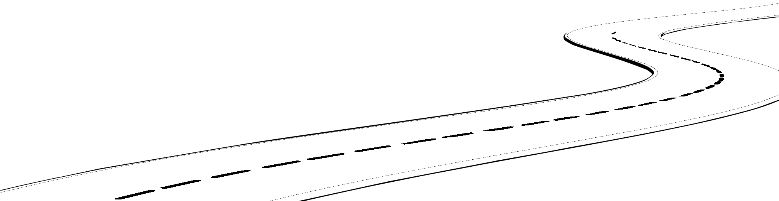
AWS Cloud Adoption
Framework
Design a Network on AWS Workshop v2.0.51
Platform
Perspective
© 2017 Amazon.com, Inc. and its affiliates. All rights reserved. May not be copied, modified, or distributed in whole or in part without the express consent of Amazon.com, Inc.

Slide 2
Agenda
Platform
Prerequisites
Intended Audience
Scope
Outcomes
Sections
Multi-VPC or Multi-Account Pattern
Multi-Account Strategy
AWS Regions

Slide 3
Agenda (continued)
Platform
Subnets & Sizes
Security Groups & Network ACLs
VPC Connectivity
Name Resolution
Auditing & Logging

Slide 4
Prerequisites
Platform
AWS Technical Essentials course or equivalent knowledge of AWS services would be beneficial but not required

Slide 5
Intended Audience
Platform
Network & Security Decision Makers
To help make network architecture & connectivity decisions
Network & Security Implementers
To help with the network architecture & connectivity implementation

Slide 6
Scope
Platform
Network Design
Provide prescriptive guidance to design a regional or global network architecture on AWS

Slide 7
Outcomes
Platform
Decisions
Decisions on pertinent network architectural design & connectivity options
Network Design
Network design document with reference architecture

Slide 8

Multi-VPC or Multi-Account Pattern

Slide 9
What is an Amazon VPC
Platform
Virtual isolated network that you define in which you can launch AWS resources such as Amazon EC2 instances
Complete control of your virtual networking environment such as
Set your own IP address ranges
Create subnets
Configure routing tables and network gateways
Extend your corporate network to the AWS Cloud

Slide 10
What is an AWS Account
Platform
Simply an Amazon.com account that is enabled to use AWS products
Used as an administrative boundary
From an AWS account you can
View your AWS account activity & usage reports
Manage your AWS Security Credentials
Provision AWS services such as Amazon VPC

Slide 11
How do you Stage your Applications
Platform
Most organizations establish 3 or 4 environments to stage their applications
Common Application Environment Names
Sandbox/POC/Lab
Development
Integration, Test, Staging, QA
Pre-Production, UAT
Production

Slide 12
Organizing Application Environments
Platform
Most customers choose between 2 patterns to group or isolate their application environments
Multi-VPC Pattern
Multi-Account Pattern

Slide 13
What is the Multi-VPC Pattern
Platform
Purpose
Used to group application environments into separate VPCs
Criteria
Single team
Single team authorized to provision infrastructure to Dev & Prod
Use Cases
Startups or small to midsize business (SMB)
Managed Service providers (MSPs)
Software as a Service (SaaS) providers

Slide 14
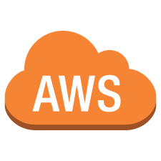
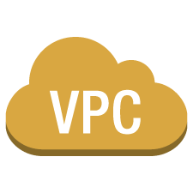
Multi-VPC Pattern Diagram
Platform
Development
Amazon VPC
Integration
Amazon VPC
Pre-production
Amazon VPC
Production
Amazon VPC

Slide 15
What is the Multi-Account Pattern
Platform
Purpose
Isolate AWS administration of application environments into separate AWS accounts
Criteria
Multi-Team
One team authorized to provision infrastructure to Dev
A different team authorized to provision infrastructure to Prod
Use Cases
Enterprises
Public Sector

Slide 16
Multi-Account Pattern Diagram
Platform
Amazon VPC
Amazon VPC
Amazon VPC
Amazon VPC
Development
AWS Account
Integration
AWS Account
Pre-production
AWS Account
Production
AWS Account

Slide 17
Multi-Account & VPC Combination Diagram
Platform
Production
Amazon VPC
Development
Amazon VPC
Production
AWS Account
Integration
Amazon VPC
Non-Production AWS Account

Slide 18
Ideas for Choosing a Pattern
Platform
Most large organizations that support multiple teams and have formal application governance and isolation requirements commonly use which pattern?
Multi-Account Pattern
Most organizations that support a single team with full control over all resources in Dev & Prod environments commonly use which pattern?
Multi-VPC Pattern

Slide 19
Decision Point: Multi-VPC or Multi-Account Pattern
Platform
Which grouping or isolation pattern would you like to use to organize your application environments?
Multi-VPC for single team
Use multiple VPCs to organize and group your application environments
Multi-Account for multi-team
Use multiple AWS accounts to organize and isolate your application environments

Slide 20
Multi-Account Pattern Strategy

Slide 21
What is AWS Organizations
Platform
Service that enables customers to centrally manage policies across multiple AWS accounts
Create accounts and invite existing accounts to join your organization and organize them into groups called organizational units (OUs)
Attach policy-based controls called Service Control Policies (SCPs) to centrally control AWS service use across multiple AWS accounts
Simplify billing for multiple accounts by enabling a single payment method through consolidated billing

Slide 22
What is AWS Consolidated Billing
Platform
A feature to consolidate payment for multiple member accounts by designating one of them to be the master account
The master account can see a combined view of AWS charges incurred by all member accounts, as well as view a cost report for each individual account

Slide 23
Common Multi-Account Pattern
Platform
Root
Master Account (Root)
Dev
Test
Prod
OUs
Accounts
Isolation Account
Centralized Account
Dev
Account
Test
Account
Prod
Account

Slide 24
Ideas on AWS Accounts
Platform
Master Account
Dedicated account for sharing payment method across all other linked accounts
No Amazon VPC and no resources
Isolation Account (optional)
Dedicated isolation account for virus, malware, and other similar investigations
Centralized/Shared Services Account
Dedicated account for centralized services such as monitoring, logging, backup, and name resolution
Peered to application environment accounts

Slide 25
Ideas on AWS Accounts (continued)
Platform
Development Account
Dedicated account with maximum flexibility and permissions for application developers
Developers can SSH/RDP to most instances
Test Account
Dedicated account for provisioning using automation or pipelines
Developers cannot SSH/RDP to most instances
Production Account
Dedicated account for provisioning using automation or pipelines
Developers unable to SSH/RDP to most instances

Slide 26
Decision Point: AWS account(s)
Platform
How many AWS accounts are you going to start out with?
AWS Recommendation
For multi-account pattern, start with 6 Amazon AWS accounts

Slide 27
Decision Point: Organizational Units
Platform
How many organizational units (OUs) are you going to start out with?
AWS Recommendation
For multi-account pattern, start with one OU for each application environment or 3 for Dev, Test, Prod

Slide 28
Decision Point: Consolidated Billing
Platform
When using the multi-account pattern, what AWS account will act as your master account?
AWS Recommendation
Start with 1 dedicated master account without resources

Slide 29
Decision Point: VPCs per AWS Account
Platform
How many VPCs would you like to use for each AWS account?
AWS Recommendation
Start with 1 Amazon VPC per AWS account

Slide 30
AWS Regions

Slide 31
What is an AWS Region
Platform
Geographic locations that contain multiple data centers called Availability Zones (AZs)
Each region is completely isolated and independent from other regions
Each region consists of 2 or more AZs to support high availability (HA) through AZ independence

Slide 32
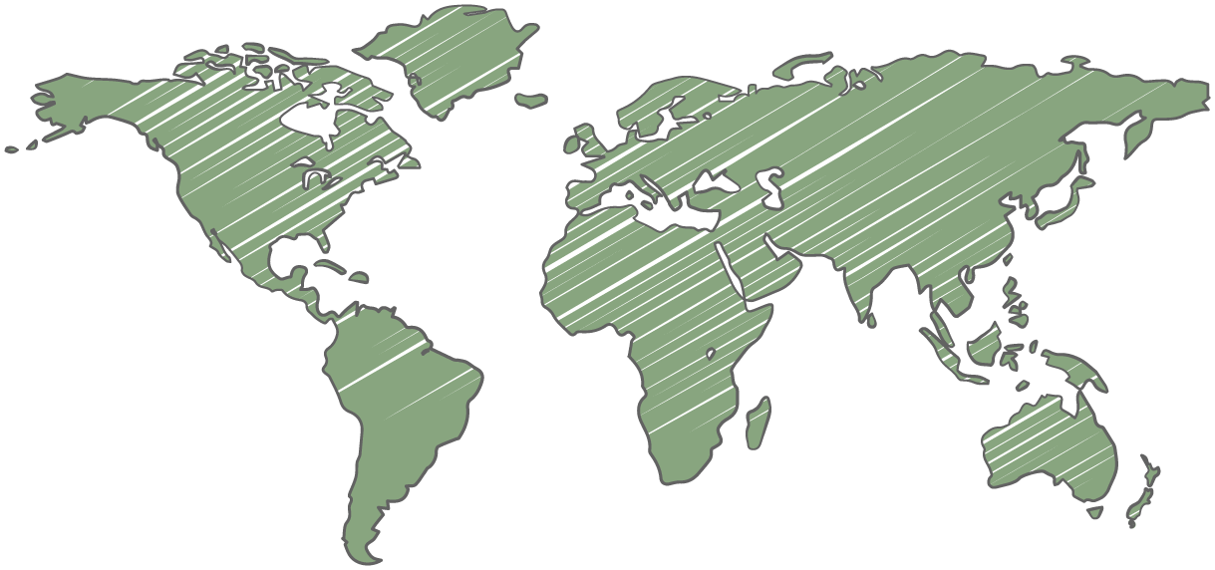

We have 16 AWS Regions World-wide
Platform
North America (6)
Canada (Montreal)
GovCloud (US)*
US East (N. Virginia)
US East (Ohio)
US West (N. California)
US West (Oregon)
Europe (3)
UK (London)
EU (Frankfurt)
EU (Ireland)
Asia Pacific (6)
Asia Pacific (Tokyo)
Asia Pacific (Seoul)
Asia Pacific (Singapore)
Asia Pacific (Sydney)
Asia Pacific (Mumbai)
China (Beijing)*
South America (1)
South America (Sao Paulo)
* Requires special AWS account

Slide 33
What are Availability Zones
Platform
Isolated data centers that are connected to each other over low-latency links within the same region
Using 2 or more AZs within a region can provide support for capabilities such as synchronous database replication and better pricing when using Amazon EC2 Spot instances

Slide 34
Availability Zones are Notated as Letters
Platform
42 Availability Zones (AZs)
Example
US East (N. Virginia)
us-east-1a
us-east-1b
us-east-1c
us-east-1d
US East (VA)
Availability Zone A
Availability Zone B
Availability Zone C
Availability Zone D

Slide 35
Criteria for Choosing an AWS Region
Platform
Data sovereignty & compliance requirements
Proximity to your existing on premises data centers or the majority of your customers
Differences in AWS services launched within a region or regional specific costs

Slide 36
Ideas for Choosing an AWS Region
Platform
Most organizations choose an initial region closest to their data centers or customers
New York
US East (N. Virginia)
Netherlands
EU (Ireland) or EU (Frankfurt)
Philippines
Asia Pacific (Singapore)
Argentina
South America (Sao Paulo)

Slide 37
Criteria for Choosing AZs per Region
Platform
Start with 2 Availability Zones Per Region
Most applications can be designed to support 2 AZs but may not benefit from more due to utilizing data sources that only support primary/secondary failover
For heavy Amazon EC2 Spot instance usage or data sources that go beyond active/passive, such as Amazon DynamoDB, there may be benefit to use more than 2 AZs

Slide 38
Ideas for Choosing AZs per Region
Platform
How many AZs would be recommended for each situation?
Intend to heavily use Amazon EC2 Spot instances
2 AZs or more for better pricing
Most applications have data sources such as MySQL, MS SQL Server, and Oracle
2 AZs to support active/passive
Most applications will have data sources such as Amazon DynamoDB, Casandra, or MongoDB
2 AZs or more for extremely high availability

Slide 39
Decision Point: Your Initial AWS Region
Platform
What initial AWS region would you like to move forward with?
AWS Recommendation
Start with 1 AWS Region

Slide 40
Decision Point: AZs per Region
Platform
How many Availability Zones per region would you like to initially move forward with?
AWS Recommendation
Start with 2 Availability Zones per AWS Region

Slide 41
Subnets & Sizes

Slide 42
What is CIDR Notation
Platform
Classless Inter-Domain Routing (CIDR)
CIDR notation is used for specifying IP addresses and their associated routing prefixes
Examples of CIDR notation
10.0.0.0/16 (represents 65,536 hosts)
…
10.0.0.0/20 (represents 4,096 hosts)
10.0.0.0/21 (represents 2,048 hosts)
10.1.0.0/22 (represents 1,024 hosts)
10.2.0.0/23 (represents 512 hosts)
10.3.1.0/24 (represents 256 hosts)
Note: Observe the relationship between the numbers, hosts double as the CIDR decrements. For example, two /24 CIDR block support the same number of hosts as one /23 CIDR block

Slide 43
What are Subnets
Platform
Subnets are segments or partitions of a VPC network
10.0.0.0/18
10.0.64.0/18
10.0.192.0/19
10.0.224.0/19
10.0.0.0/16

Slide 44
Two Types of Subnets
Platform
Public subnet
Public subnets have a routing table entry to an Internet Gateway (IGW) to support inbound/outbound access to the Internet
Private subnet
Private subnets do not have a routing table entry to an Internet Gateway (IGW) and typically have a proxy/NAT Gateway to support outbound-only Internet access

Slide 45
Recommendations when using Subnets
Platform
Start with 2 subnets per AZ
Consider using 1 public and 1 private subnet per Availability Zone to provide adequate IP address capacity for auto scaling
Use subnets to delineate Internet accessibility
Avoid creating subnets to organize specific applications (e.g. MySQL database subnet) or tiers of an application (e.g. web-tier, app-tier, or data-tier subnets) as this can increase complexity and can contribute to exhausting your IP address space.
Consider larger subnets over smaller ones (use /24 or larger)
Favor creating large subnets over multiple small subnets as this simplifies workload placement. For example, choosing where to place a workload among 10 small subnets increases complexity and coordination. It is no longer necessary to limit Address Resolution Protocol (ARP) broadcast domains as this is solved by the VPC.

Slide 46
Ideas when using Subnets
Platform
Which application instance would you place in each subnet type?
Web-tier instances
Public subnet
Batch-tier instances
Private subnet
App-tier instances
Private subnet
Data-tier instances
Private subnet

Slide 47
Ideas for Subnet Sizes
Platform
Most customers allocate roughly double the IP addresses for private subnets than public subnets
If a public subnet is using a /22, what would the CIDR notation be to represent double that number for the private subnet?
/21

Slide 48
Decision Point: IP Address Range
Platform
What private IP address range is available for use on each VPC?

Slide 49
Decision Point: Subnets per AZ
Platform
How many subnets and what type of subnets would you like to use per Availability Zone?
AWS Recommendation
Start with 1 public and 1 private subnet per Availability Zone

Slide 50
Decision Point: Subnet Sizes
Platform
Using CIDR notation, what will the subnet sizes be for each Availability Zone?
AWS Recommendation
Start with large subnets (/24 or larger)
Allocate double the IP addresses for the private subnet than the public subnet

Slide 51
Security Groups & Network ACLs

Slide 52
What are Security Groups
Platform
Security Groups are required virtual firewalls that control traffic for one or more instances
Security Groups deny all incoming traffic by default and use stateful allow rules that can filter based on TCP, UDP, and ICMP protocols
Security Groups can define a source as either a CIDR block or another Security Group to handle situations like auto scaling

Slide 53
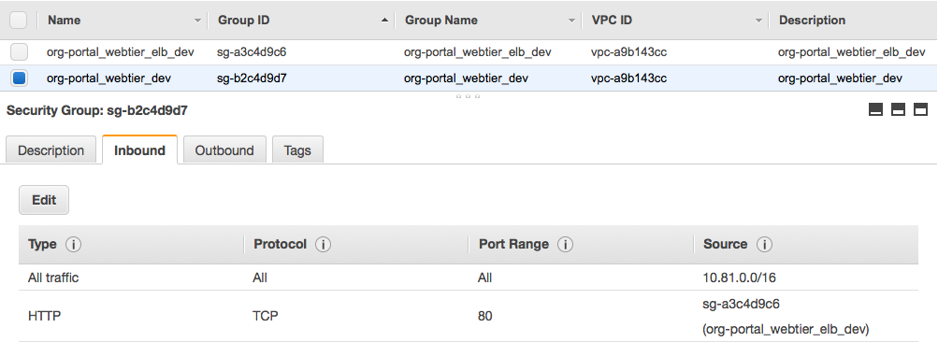
Example CIDR and Security Group Source
Platform

Slide 54
How are Security Groups Configured
Platform
Security Groups have an outgoing rule allowing all traffic to all destinations by default
Modifying the default outbound rule on security groups increases complexity and is not recommended unless required for compliance
Most organizations create security groups with inbound rules for each application tier

Slide 55
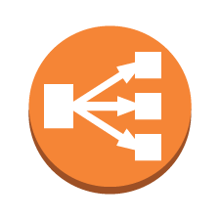

Security Group Chaining Diagram
Platform
Security Groups per Tier (Public Subnets)
Webtier ELB
Security Group
web
Webtier
Security Group
web
public subnet
public subnet
Availability Zone A
Availability Zone B

Slide 56
Security Group Chaining Diagram
Platform
Security Groups per Tier (Private Subnets)
Apptier ELB
Security Group
app
Apptier
Security Group
app
data
Datatier
Security Group
data
private subnet
private subnet
Availability Zone A
Availability Zone B

Slide 57
Security Group Chaining Diagram
Platform
Security Group Rules per Application Tier
Webtier ELB
Security Group
Inbound Rule
Allow TCP Port 443
Source: 0.0.0.0/0 (Any)
Webtier
Security Group
Inbound Rule
Allow TCP Port 80
Source: Webtier ELB
web
web
Inbound Rule
Allow TCP Port 8080
Source: Webtier
Apptier ELB
Security Group
Apptier
Security Group
Inbound Rule
Allow TCP Port 8080
Source: Apptier ELB
app
app
data
Datatier
Security Group
data
Inbound Rule
Allow TCP Port 3306
Source: Apptier
Availability Zone A
Availability Zone B

Slide 58
Security Group Architecture
Platform
Security Group Rules for One-to-Many
Jumpbox/Bastion
Security Group
Inbound Rule
Allow TCP Port 22
Source: 0.0.0.0/0
jump box
jump
box
Webtier
Security Group
Inbound Rules
Allow TCP Port 22
Source: Jumpbox
web
web
Apptier
Security Group
Inbound Rule
Allow TCP Port 22
Source: Jumpbox
app
app
Availability Zone A
Availability Zone B

Slide 59
Security Group Architecture
Platform
Security Group Rules for Many-to-One
Agent Collector
Security Group
Inbound Rule
Allow TCP Port 4546
Source: VPC CIDR
Allow UDP Port 162
Source: VPC CIDR
collect
collect
Webtier
Security Group
Inbound Rules
Allow TCP Port 80
Source: Webtier ELB
web
web
Apptier
Security Group
Inbound Rule
Allow TCP Port 8080
Source: Apptier ELB
app
app
Availability Zone A
Availability Zone B

Slide 60
What are Network ACLs
Platform
Network ACLs are optional virtual firewalls that control traffic in and out of a subnet
Network ACLs allow all incoming/outgoing traffic by default and use stateless rules to allow or deny traffic

Slide 61
Ideas on Security Groups
Platform
True or False. An Amazon EC2 instance can be launched without a security group?
False, security groups (aka firewalls) are required to launch an EC2 instance
True or False. Security Groups deny all incoming traffic and allow all outgoing traffic by default?
True

Slide 62
Ideas on Network ACLs
Platform
True or False. Network ACLs are stateless and have performance and complexity implications?
True
True or False. Network ACLs deny all incoming traffic and allow all outgoing traffic by default?
False, they allow all incoming and outgoing traffic by default
When should you use Network ACLs?
Network ACLs should only be used when required by compliance. Most customers avoid network ACLs and use security groups for controlling inbound and outbound traffic instead.

Slide 63
Decision Point: Security Group Strategy
Platform
Will you use Security Groups as your primary firewall to control traffic to Amazon EC2 instances?
AWS Recommendation
Use security groups as primary firewall to control traffic

Slide 64
Decision Point: Network ACL Strategy
Platform
What will your strategy be around using network ACLs on Amazon VPC subnets?
AWS Recommendation
Use network ACLs only when required by policy and rules are identical and applicable to all Amazon EC2 instances contained in the subnet

Slide 65
VPC Connectivity

Slide 66
What is the AWS Management Console
Platform
Web-based user interface to access and manage Amazon Web Services such as Amazon VPC
The Console facilitates cloud management for all aspects of your AWS account
Supports recent browser versions of Google Chrome, Mozilla Firefox, Microsoft IE, Microsoft Edge, and Apple Safari
You can also use the AWS Console mobile app to view resources on the go

Slide 67
What is the AWS Command Line Interface
Platform
AWS CLI is a unified tool to manage AWS services
Controls multiple AWS services from the command line and automates them through scripts
Written in Python and runs on Linux, Windows, and Mac

Slide 68
What is Hardware VPN
Platform
You create a Hardware Virtual Private Network (VPN) connection between your corporate data center and your Amazon VPC
Leverage the AWS cloud as an extension of your corporate data center
All traffic can be routed between your AWS instances and your corporate data center using an encrypted tunnel over IPsec

Slide 69
What is AWS Direct Connect
Platform
Dedicated private network connection to AWS
Consistent network performance
Speeds of 50-500Mbps, 1Gbps, and 10Gbps
Most hardware VPN solutions top at 4Gbps
Supports Active/Active and Active/Passive Border Gateway Protocol (BGP) Multipath

Slide 70
What is VPC Peering
Platform
Networking connection between two VPCs that enables you to route traffic between VPCs using private IP addresses
Instances in either VPC can communicate with each other as if they were within the same network
VPC peering connections can be created between your own VPCs or with a VPC in another AWS account in the same region

Slide 71
Several Ways to Connect to your VPC
Platform
Over the Internet via AWS Management Console or AWS Command Line Interface (AWS CLI)
Hardware Virtual Private Network (VPN) over IPsec
AWS Direct Connect
Connect privately to other VPCs through VPC peering connections

Slide 72
Criteria for VPC Connectivity
Platform
Start with over the Internet or hardware VPN
Most initial applications migrated to AWS do not require dedicated connections or data transfer rates above 4Gbps
Consider AWS Direct Connect
If your initial applications being migrated to AWS require data transfer rates above 4Gbps you may want to consider requesting AWS Direct Connect

Slide 73
Ideas for Data Center Connectivity
Platform
Which VPC connectivity option do organizations typically start with?
Over the Internet or hardware VPN
If your organization requires data transfer rates of over 4Gbps, which option would you choose?
AWS Direct Connect

Slide 74
Decision Point: VPC Connectivity
Platform
What VPC connectivity option are you initially going to move forward with?
AWS Recommendation
Start with over the Internet or hardware VPN
Use VPC peering from each application environment to a centralized VPC to share services

Slide 75
Name Resolution

Slide 76
What is Amazon Route 53
Platform
Global Domain Name System (DNS) for hosting public and private zones
Supports DNS health checks to route traffic to healthy endpoints
Multiple routing types
Simple Routing
Weighted Routing
Latency Routing
Failover Routing
Geolocation Routing

Slide 77
Ideas on Name Resolution
Platform
Start with Amazon Route 53 to host public & private zones
Amazon Route 53 provides a feature that allows apex domains such as example.com to point to CNAME records, which is not possible with most DNS solutions. This feature may be required with using Amazon Elastic Load Balancers (ELBs) since the underlying IP addresses may periodically change.

Slide 78
Decision Point: Name Resolution Strategy
Platform
Will you use Amazon Route 53 to host public or private zones?
AWS Recommendation
Use Amazon Route 53 for public and private zones

Slide 79
Auditing & Logging

Slide 80
What is Amazon S3
Platform
Highly scalable object storage
Store and retrieve data from anywhere on the web
Files are stored as objects and organized into high-level folders called buckets
Supports multi-part upload for large files and event notifications when objects are uploaded

Slide 81
How to Organize Amazon S3 Buckets
Platform
S3 buckets should be organized around lifecycle policies
For example, a bucket named “logs” may have lifecycle policy “delete after 120 days” or a bucket named “records” with a lifecycle policy that archives objects after 180 days
Consider separate S3 buckets if objects are owned by multiple cost centers since tags exist at the bucket level
Consider separate S3 buckets if some objects are publically available while others are internal only

Slide 82
Common Bucket Names
Platform
Common S3 buckets names
logs
reports
code
sites
projects
backups

Slide 83
What is AWS CloudTrail
Platform
Managed service that records AWS API calls for your account and delivers log files to Amazon S3
Receive Amazon SNS notifications when specific API activity occurs
Increased visibility into user activity especially when enabled across all regions
Records information like identity of the API caller, time, source IP, request parameters, and response elements returned by the AWS service

Slide 84
What are VPC Flow Logs
Platform
Feature that enables you to capture information about the IP traffic going to and from network interfaces in your VPC
Flow log data is stored in Amazon CloudWatch Logs
Data can help you troubleshoot why specific traffic is not reaching an instance
Records information such as account id, interface id, source IP address, destination IP address, source port, destination port, protocol, packets, bytes, start time, end time, action (accept/reject), log-status

Slide 85
What is AWS Lambda
Platform
Compute service that runs stateless Node.js, Java, and Python code in response to an event
Starts code within milliseconds of an event such as an image upload, in-app activity, website click, or output from a connected device
Allows running code without managing infrastructure like Amazon EC2 instances and auto scaling groups
AWS Lambda can be scheduled to run on a time interval

Slide 86
What is AWS Config
Platform
Managed service that provides AWS resource inventory, configuration history, and configuration change notifications
Determine how a resource was configured at a point in time
Export a complete inventory of AWS resources with all configuration details
Enables compliance auditing, security analysis, resource change tracking, and troubleshooting

Slide 87
Ideas for Auditing & Logging
Platform
What AWS service logs API requests and stores them in Amazon S3?
AWS CloudTrail
What AWS service logs flow data into Amazon CloudWatch Logs?
VPC Flow Logs
What AWS service logs configuration changes into Amazon S3?
AWS Config

Slide 88
Decision Point: Amazon S3
Platform
What naming convention will you use for Amazon S3 buckets?
What Amazon S3 buckets will you initially create for your organization?

Slide 89
Decision Point: AWS CloudTrail
Platform
Will you enable AWS CloudTrail in all regions?
AWS Recommendation
Always enable AWS CloudTrail for all regions

Slide 90
Decision Point: VPC Flow Logs
Platform
Will you enable VPC Flow Logs for your VPCs?

Slide 91
Decision Point: AWS Lambda
Platform
Will you use AWS Lambda to schedule tasks or respond to auditing and logging events?

Slide 92
Decision Point: AWS Config
Platform
Will you enable AWS Config to track change history?

Slide 93
AWS Cloud Adoption
Framework
Any Questions?

Slide 94
Appendix A - CIDR Not Your Friend?
Platform
CIDR Hosts
The list below shows the number of hosts for each CIDR:
/16 – 65,536 hosts
/17 – 32,768 hosts
/18 – 16,384 hosts
/19 – 8,192 hosts
/20 – 4,096 hosts
/21 – 2,048 hosts
/22 – 1,024 hosts
/23 – 512 hosts
/24 – 256 hosts
/25 – 128 hosts
/26 – 64 hosts
/27 – 32 hosts
/28 – 16 hosts
Special Cases
/0 – All hosts
/32 – 1 host

Slide 95
Appendix B - CIDR Not Your Friend?
Platform
CIDRs for 2 Availability Zones
The list below assumes 2 Availability Zones with 1 public and 1 private subnet per zone:
VPC /16
2 Private /18, 2 Public /19, Remaining /18
VPC /17
2 Private /19, 2 Public /20, Remaining /19
VPC /18
2 Private /20, 2 Public /21, Remaining /20
VPC /19
2 Private /21, 2 Public /22, Remaining /21
VPC /20
2 Private /22, 2 Public /23, Remaining /22
VPC /21 -
2 Private /23, 2 Public /24, Remaining /23
VPC /22
2 Private /24, 2 Public /25, Remaining /24

Slide 96
Appendix C - CIDR Not Your Friend?
Platform
CIDRs for 3 Availability Zones
The list below assumes 3 Availability Zones with 1 public and 1 private subnet per zone:
VPC /16
3 Private /18, 3 Public /20, Remaining /20
VPC /17
3 Private /19, 3 Public /21, Remaining /21
VPC /18
3 Private /20, 3 Public /22, Remaining /22
VPC /19
3 Private /21, 3 Public /23, Remaining /23
VPC /20
3 Private /22, 3 Public /24, Remaining /24
VPC /21
3 Private /23, 3 Public /25, Remaining /25
VPC /22
2 Private /24, 3 Public /26, Remaining /26

